Slide 1
Justicia
Legal Platform for lawyers
Justicia offers the most comprehensive tools to manage and grow your law practice which is easy-to-use and can be accessed from anywhere on any device. Justicia has been designed to handle all of the unique and legal specific research challenges for the legal practitioners

Slide 2
The Problem
Time consumed in Legal Research
1
Human Resources Required and Cost
2
Repetitive Legal tasks
3

Slide 3
Solution
At the core of our platform lies a legal cognitive search engine which use advanced nlp techniques to mine judgments for case related argument building.
Legal Knowledge Management System with advanced analytics delivered as a virtual agent

Slide 4
Market Size
16
3
13
Billion
Billion
Billion
TAM
Total Available Market
Market Penetration so far
>20% of the legal tech market has been captured
Target Market
Share of Market
80% of available market
Source : Boston consulting group

Slide 5
Market Validation
64% of the respondents have used legal software in their practice
92% of the respondents feel there is need for a cognitive based solution with a virtual agent interface
74% respondents are willing to pay for a monthly subscription model
What our customers think about our product !!

Slide 6
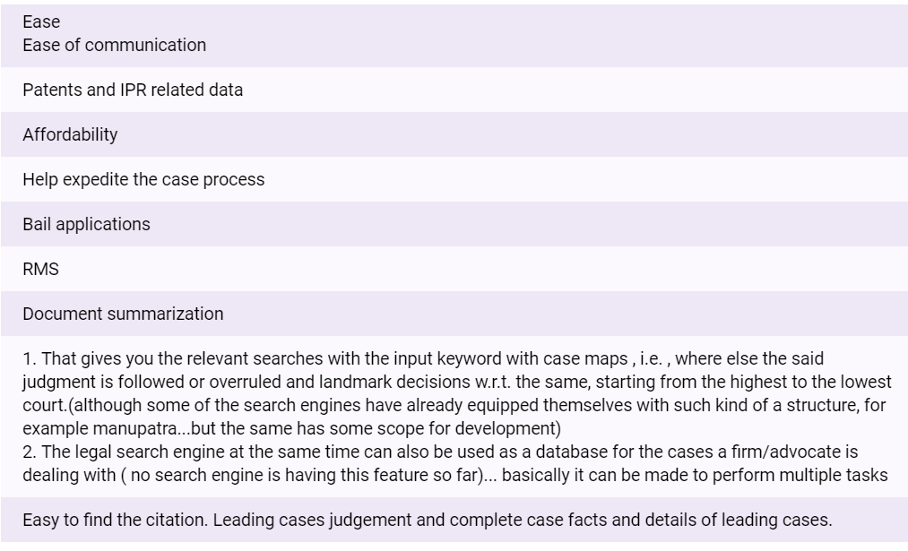
What they think are requisites of the platform

Slide 7
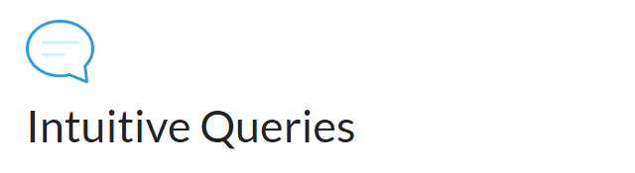
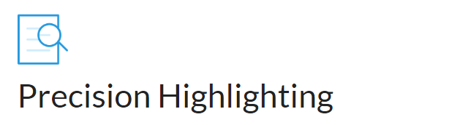
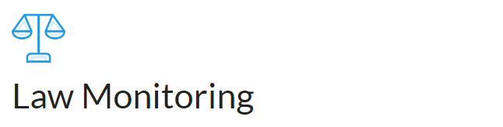
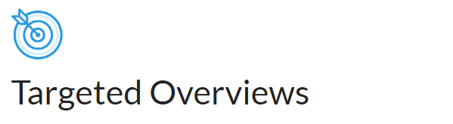
Product Features
With cutting edge NLP technology, pose your research questions like you’re talking to another lawyer.
Receive pinpoint answers from published & unpublished case law to substantive legal issues in seconds.
Justicia is trained to track developments in the law with respect to your legal issues and send notifications with any relevant legal updates.
Extract quotes and key points of law, from multiple parts of a case, providing a quick overview of what key legal analyses are discussed as they relate to your query.

Slide 8
Demo

Slide 9
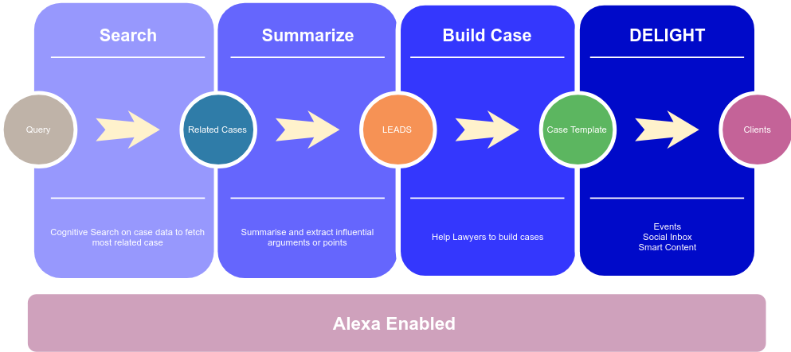

Slide 10
Business & Revenue Model

Slide 11
Market Adoption Strategy
Have strategic partnership with existing legal data providers such as Manupatra, India kanoon etc
Tie up with Law colleges across targeted geo locations Ex: Nalsar
Early bird offers during A/B
Incentivise recommendations from existing clients

Slide 12
Business Model
Monthly and yearly subscription based model

Slide 13
Product Roadmap

Slide 14
Complete Beta Version of the platform
Enhancements and Optimisation of the search engine V2
Launch Legal support services (Consulting, Para legal contractors)
31.07.18
15.09.18
29.10.18
15.12.18
15.01.19
A/B Testing of the platform with Hyderabad Bar
Launch commercially across hyderabad, Bangalore and Madras

Slide 15
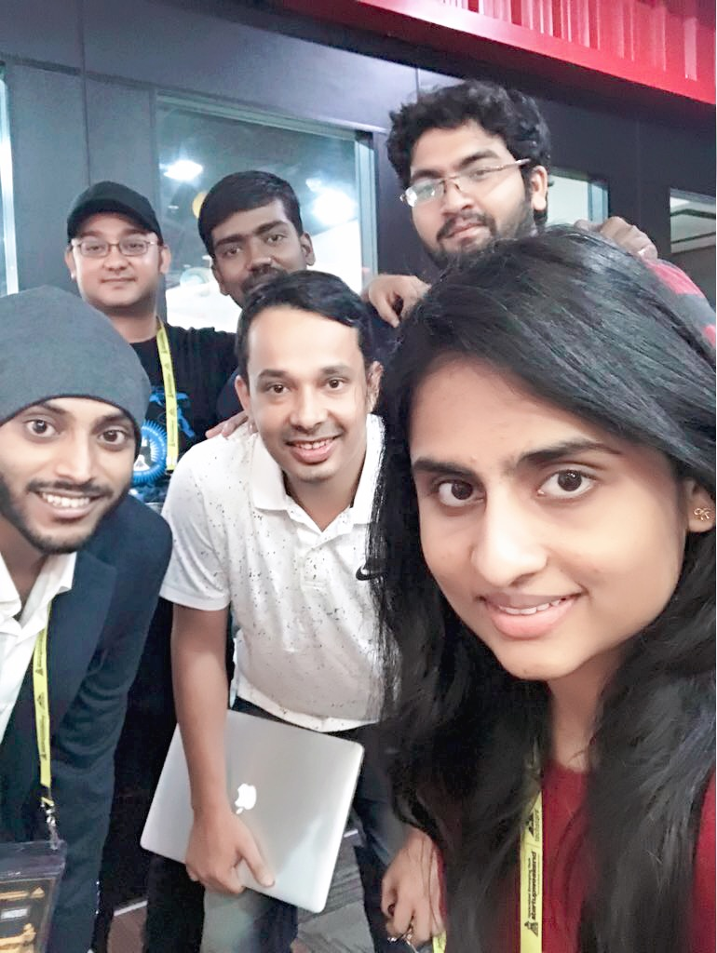
The Team
Business
Ramakrishna Mamidi - Business Analyst Deloitte
Sindhu Raju - Entreprenuer
Karan Patel - Student
Tech
Adithya Kumar - Data Scientist -DBS
Vinay - SDE Amazon, India
Bharath Varma - Data scientist
Prashanth Y - Junior data scientist

